Slide 1
IntegraDev Coding Interview Progress Slides
Intended to be used for the onsite interview to assist the understanding of making the system

Slide 2
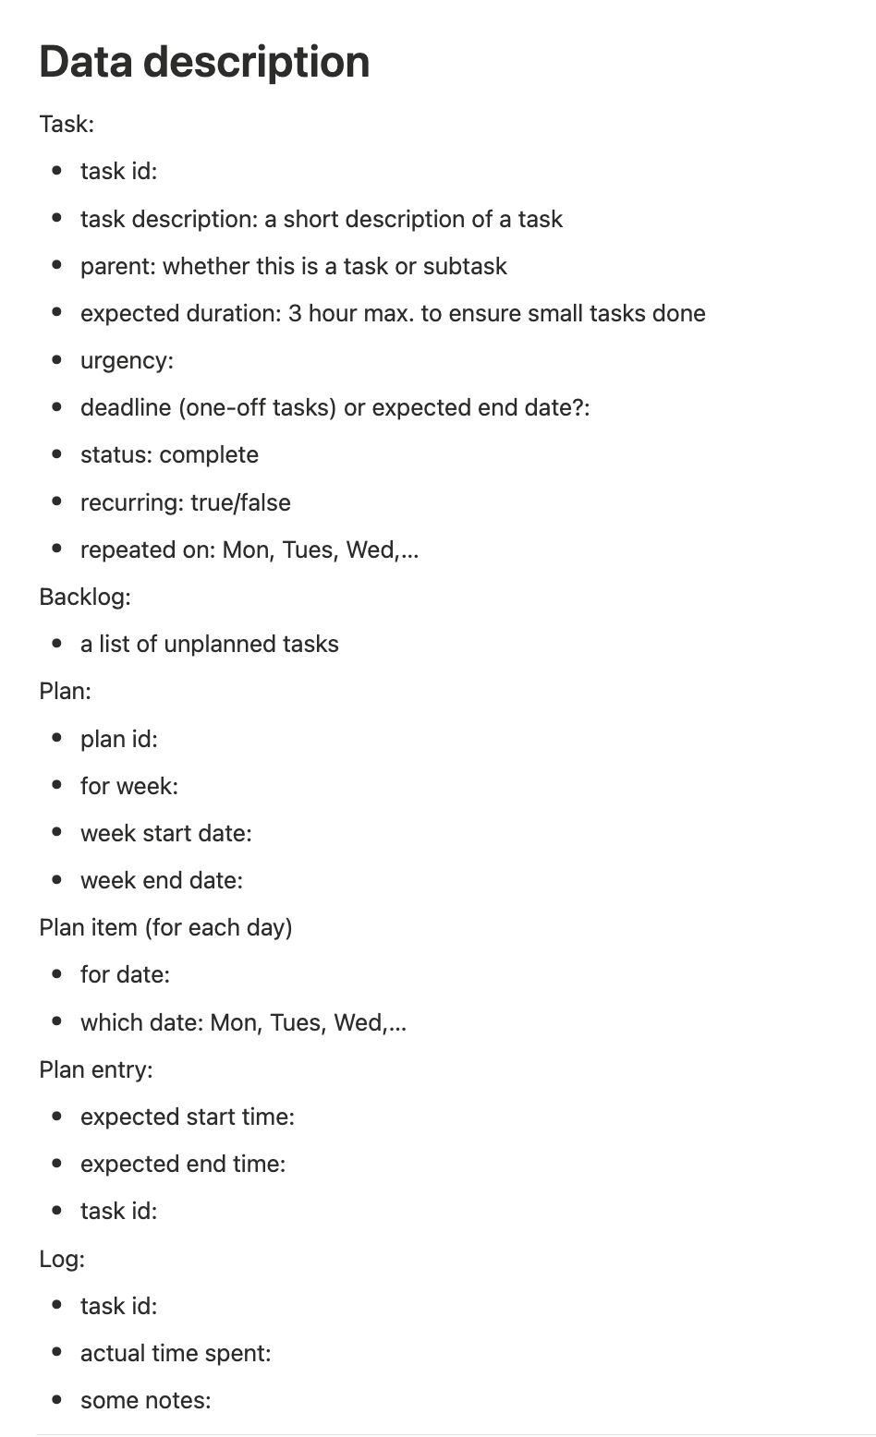
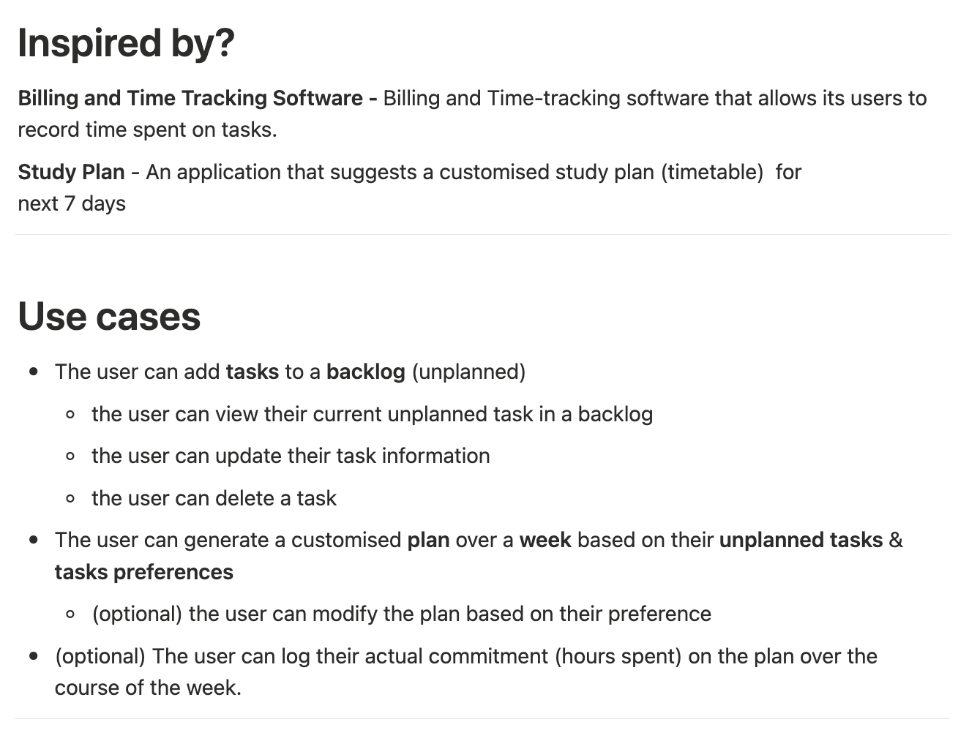
Ideas

Slide 3
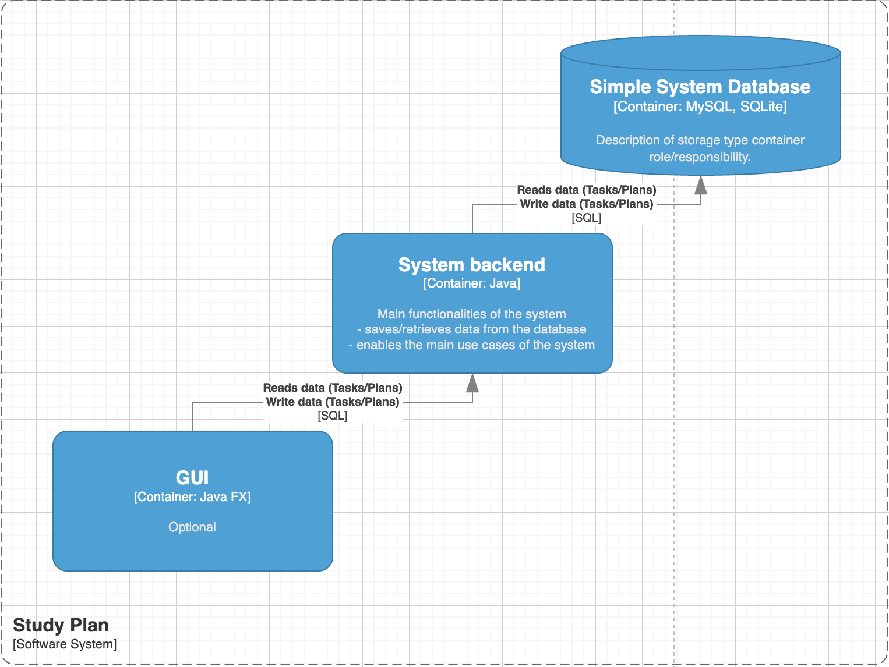
System architecture

Slide 4
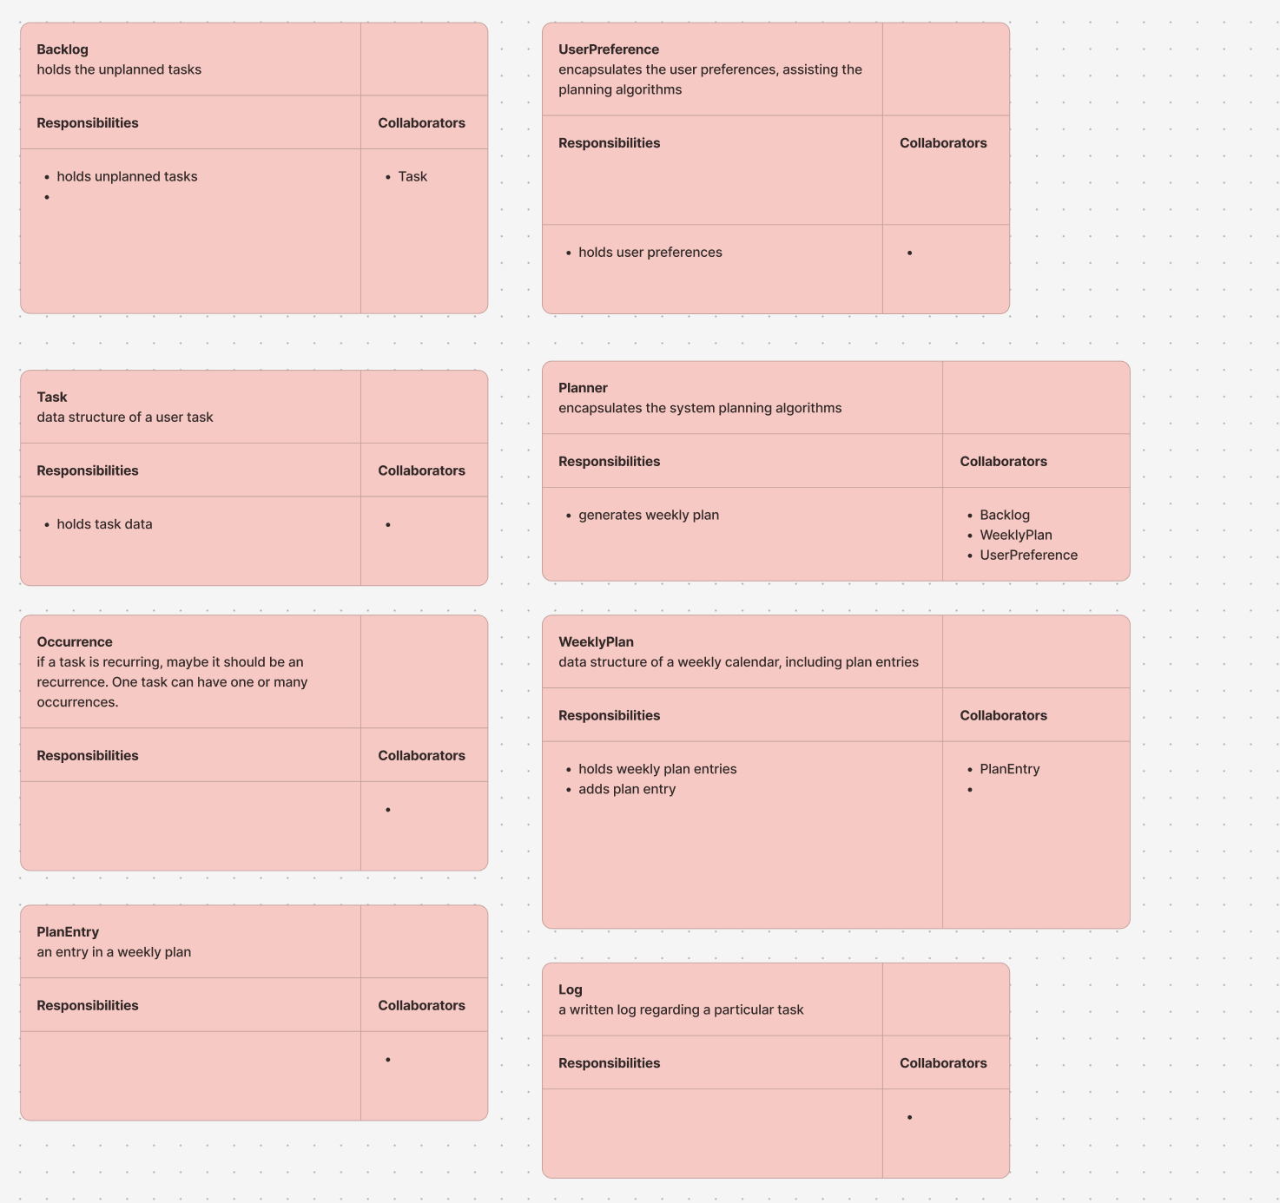
CRC Cards

Slide 5
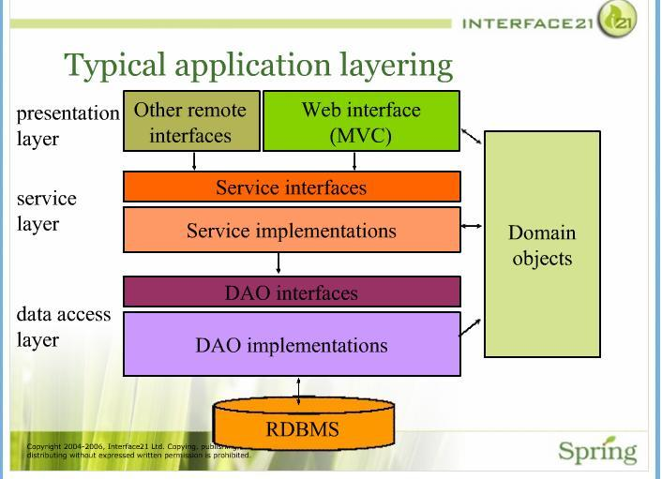
Software Architecture: Layered Architecture
https://dzone.com/articles/layered-architecture-is-good

Slide 6
Setting up time: Database
SQLite – simple to start with
Flyway – database migration tool – an overkill!
ORMLite – simple & compatible with SQLite
Have the task table ready for some intial flow development

Slide 7
Setting up time: JavaFX frontend
Was quite a challenge when using IntelliJ to build
Had to switch back to Maven and set up everything again

Slide 8
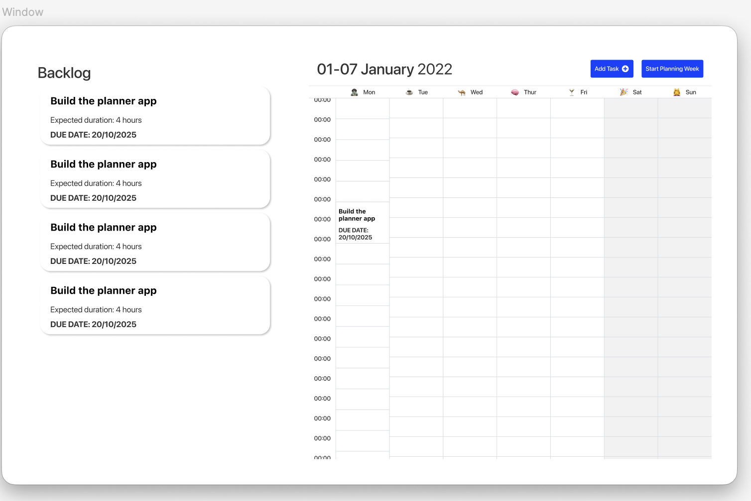
UI design

Slide 9
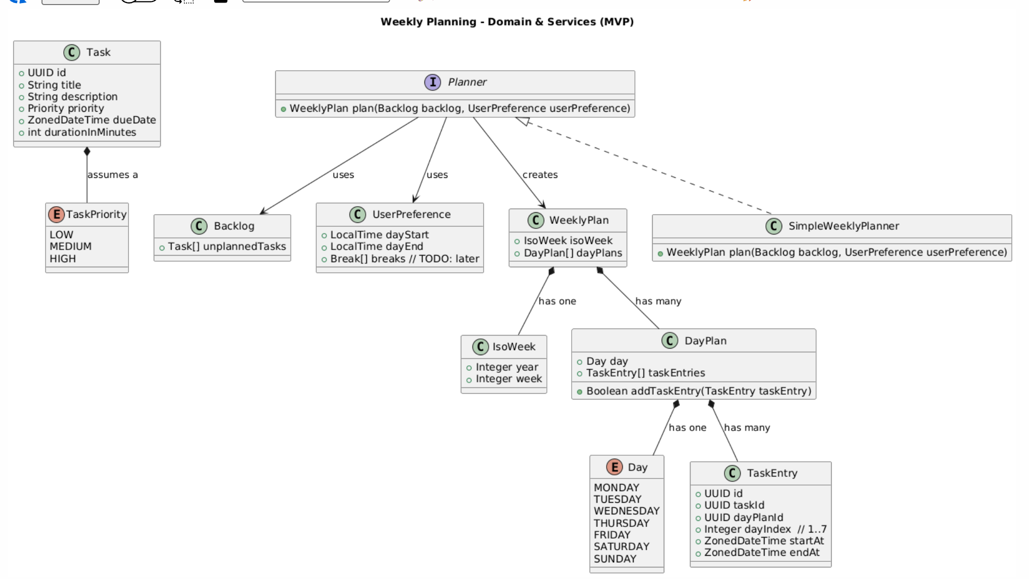
Domain design
Focus: to enable the planning algorithms to be evolved

